Slide 1


ERA: Emergency Response Assist
Jatin Madan; Sharvesh Patki; Isha Ghiria; Vaishnavi Desai
May 6, 2024

Slide 2
Objectives of ERA
Key Objectives
1.
Gunshot Detection and Localization: The emergency response system will incorporate gunshot detection and localization capabilities. This feature enhances the system's ability to swiftly identify and respond to active shooter incidents, further bolstering campus security and safety measures.
We have a desire to create a system that can assist people in case of emergencies by locating them and providing the safest exit routes to the affected.
To move toward achieving these goals, we need to build advanced machine learning and triangulation algorithms to assist the people
2.
Real-Time Tracking Algorithms: In conjunction with the existing features, the emergency response system will incorporate
real-time network tracking algorithms linked with network access points across the university campus. This feature enhances the system's ability to monitor and track the movement of individuals during emergencies, facilitating targeted assistance and evacuation procedures.
3.
Planning Escape Routes: In addition to advanced threat detection and real-time tracking capabilities, the emergency response system will integrate a feature for planning escape routes using the provided floor plans of university buildings and facilities. This feature will enhance the system's ability to guide individuals to safety during emergencies such as active shooter incidents, fires, or natural disasters.

Slide 3
The team will initiate several key activities during the first four (4) weeks, including but not limited to researching efficient algorithms to triangulate users and prepare an exit route for emergency situations
Key activities planned for the first four (4) weeks
Team ERA
Draft an Architectural Diagram for the ERA System
Build Mockups and Wireframes for the Frontend UI/UX of the application
Research on Escape Route Detection and Optimization Algorithms
Research Wi-Fi Access Point Metrics and Logs
Start daily sprint meetings with the team to review generalized use cases, identify gaps and improve collaboration.
WEEK 1-2
Create a simulation software for the Network Access Points to test User Triangulation
Setup CI/CD and DevSecOps Platform for ERA Software Management and Deployments
Start Developing UI from the designed Wireframes
Try and Validate Existing Route Detection ML Algorithms
Implement User Tracking and Triangulation
WEEK 2-4

Slide 4
Weekly status report – As of 05/04/2024
Current Project Status
Current Period | Previous Period | Trend | % Complete | Finish Date
 |  |  | 80% | 05/04/24
User Stories/Risks/Issues/Decisions/Milestones
R/I | Brief Description | Due Date
I | Build and Deploy API for Gunshot Detection | 05/04/2024
2 | Build and Deploy API for Network Logs Simulation | 05/04/2024
3 | Build the Front-end UI for ERA Dashboard | 05/04/2024
4 | Build the Front-end UI for ERA Floor Plan Input | 05/04/2024
5 | Establish the Main ERA Server to serve as the Integration Hub | 05/04/2024
G
G
Key Accomplishments: Built the Gunshot Detection Model with an Accuracy of 95%, with a gunshot detection accuracy of 99.5% Established the Main Server to function as the Integration Hub for the 3 Modules Built the Network Log Simulator to stream WIFI Access Point logs in Real Time Implemented JIRA for Project management, and onboarded the team to the platform Setup Daily Standups to meet and collaborate on the ongoing efforts
Deliverables | Finish Date | % Complete | Status
 | (Planned)
Project plan | 05/05/24 | 15% | G
User stories for ERA Development operations | 05/05/24 | 65% | G
ERA System Architectural Diagram | 04/16/24 | 15% | C
Agile Release Roadmap | 04/20./24 | 5% | G
Completed 01 sprints and below is the snapshot of the current sprint [01]
Github project archive | 05/05/24 | 0% | G
Perform Active User Simulation for ERA | 06/14/24 | 0% | G
ERA View/Update dashboard | 06/14/24 | 0% | G
Knowledge base articles for ERA System | 06/14/24 | 0% | G
Process workflow documentation | 06/14/24 | 0% | G
Activities planned for next period: Integrate all 3 Modules into a Cohesive Application using the Main ERA Server as the Hub Beautify and Materialize the Front-End Applications to give it a modern look and feel. Build the Notification API to alert the First Responders and the ERA Administration Implement the Escape Route Sharing Module to display the closest and the safest route.
G
On Track
A
Monitor Closely
C
Complete
Trending:
Improving trend for future
No change
Worsening trend for future

Slide 5
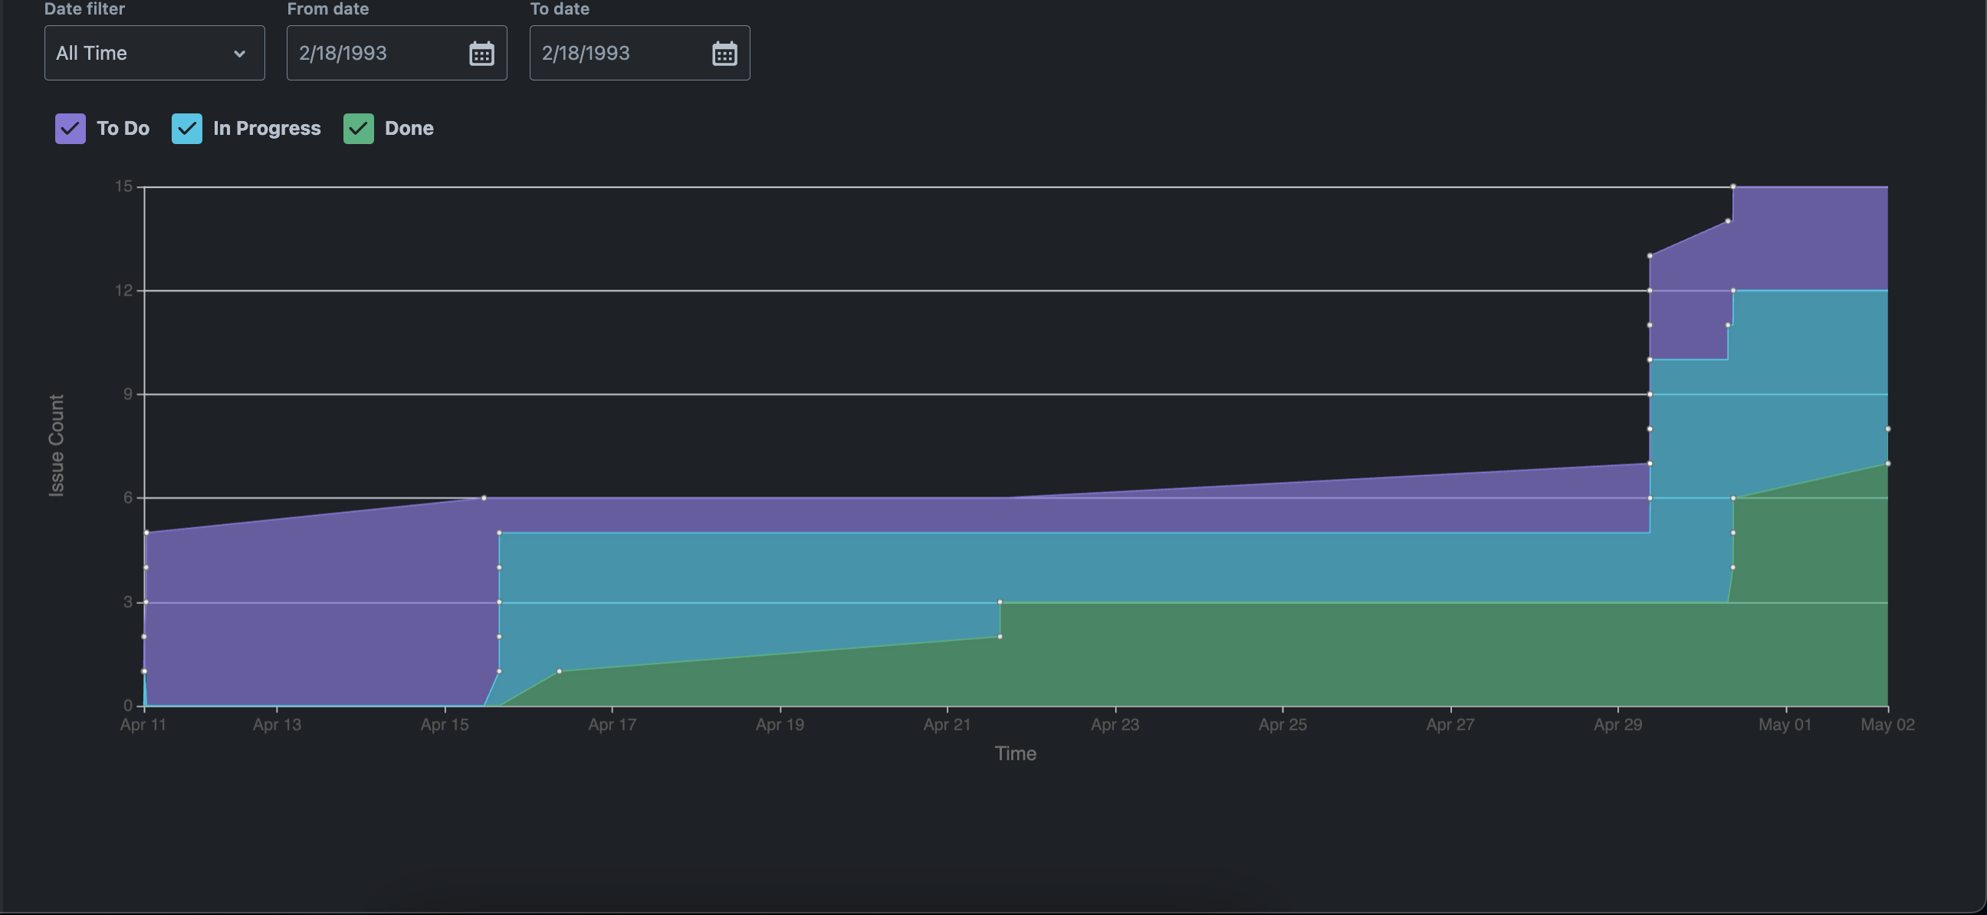
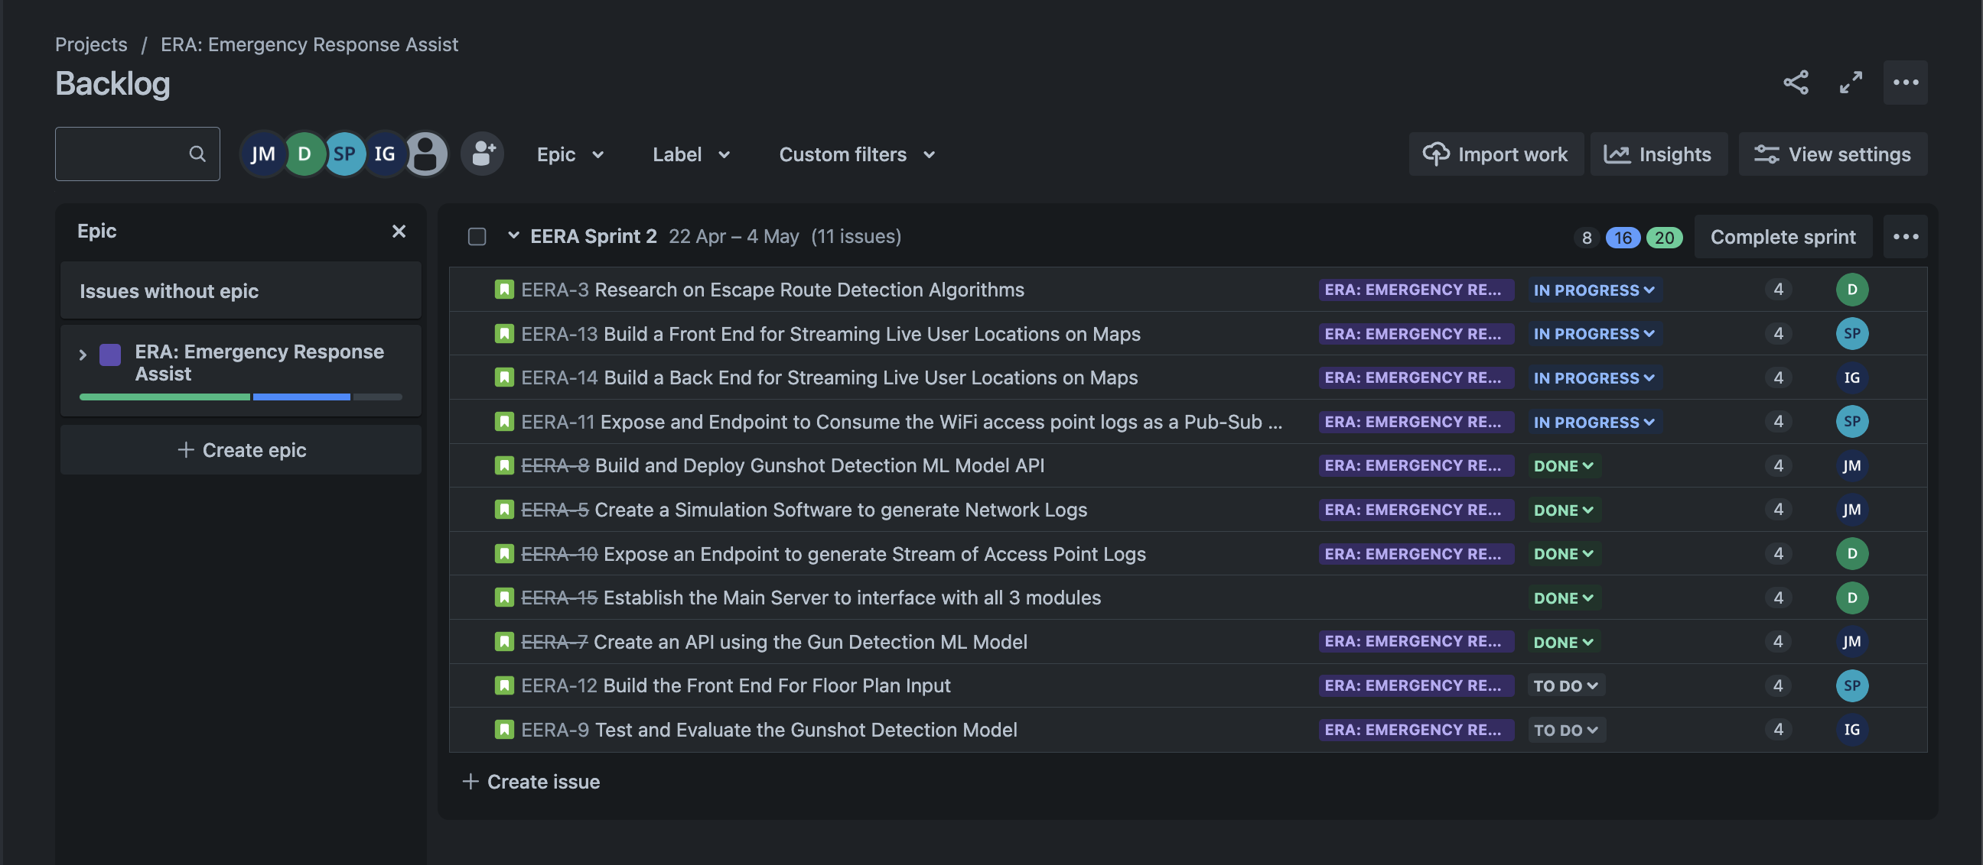
Sprint Cumulative Flow Diagram

Slide 6
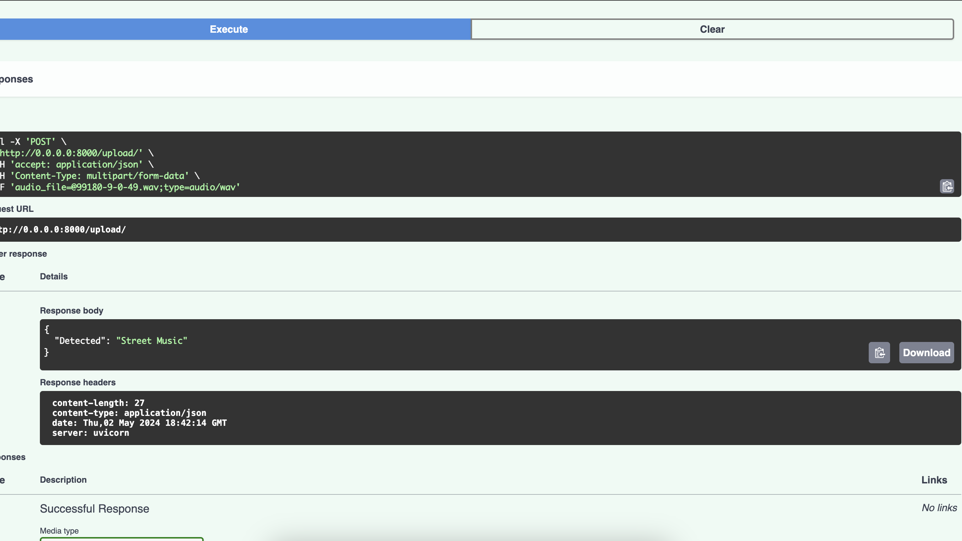
ERA: Gunshot Detection model Accuracy

Slide 7
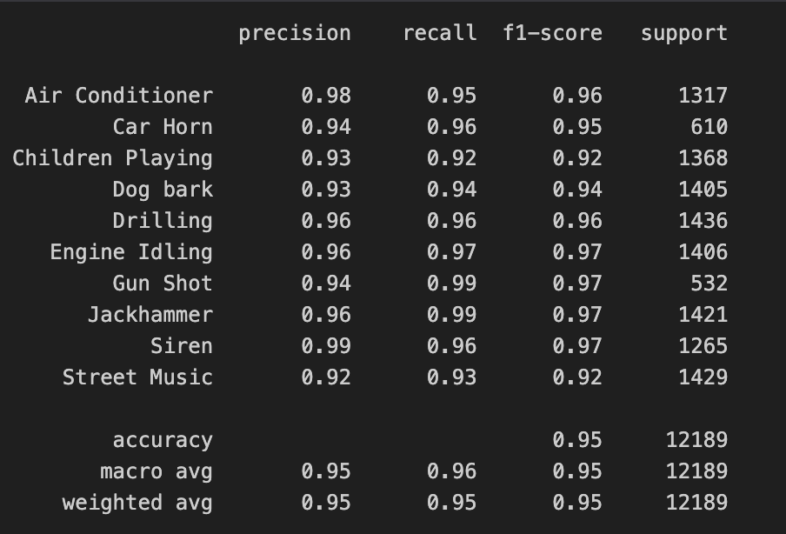
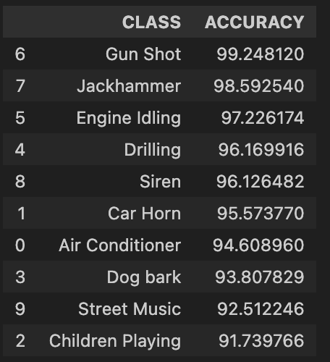
ERA: Gunshot Detection model Accuracy and Demo

Slide 8

Questions?

Slide 9
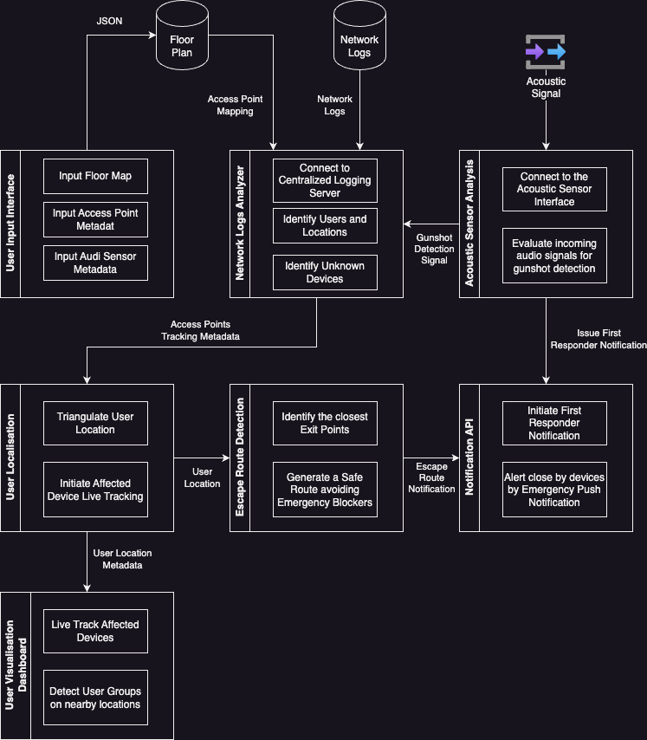
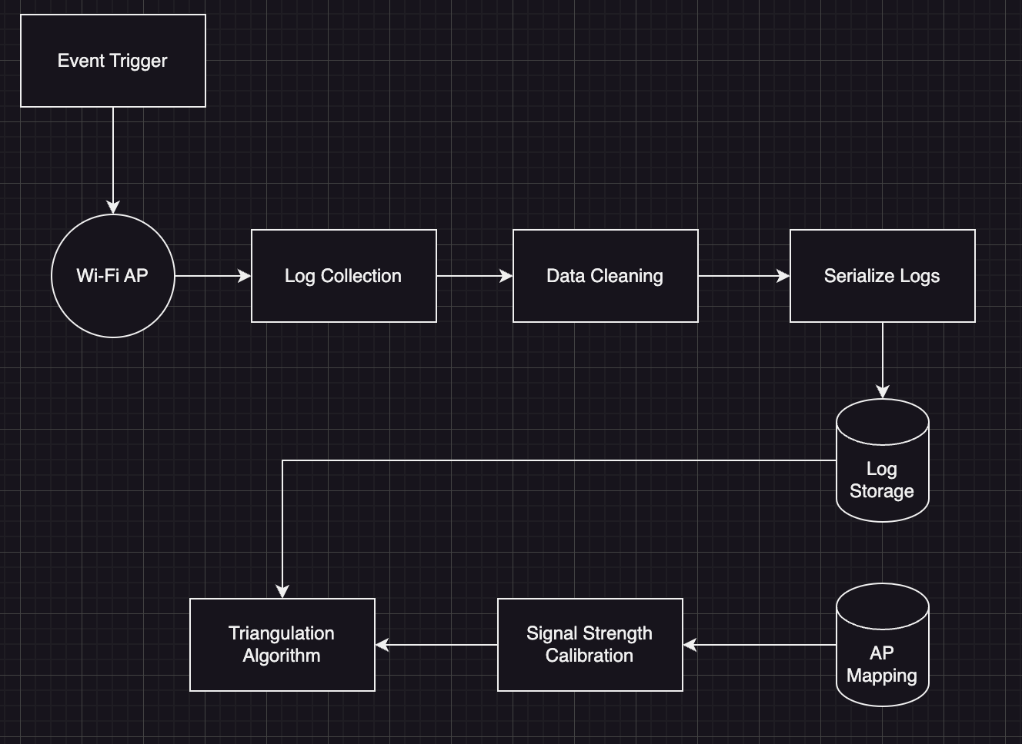
Architecture Diagram
Network Logs Analysis

